Slide 1

StableMate:
A statistical method to select stable predictors in omics data
Yidi Deng (Melbourne Integrative Genomics)
Supervised by:
Prof. Kim-Anh Lê Cao
Dr. Jarny Choi
Dr. Jiadong Mao

Slide 2
Motivation
Infer biological relationship from statistical association

Slide 3
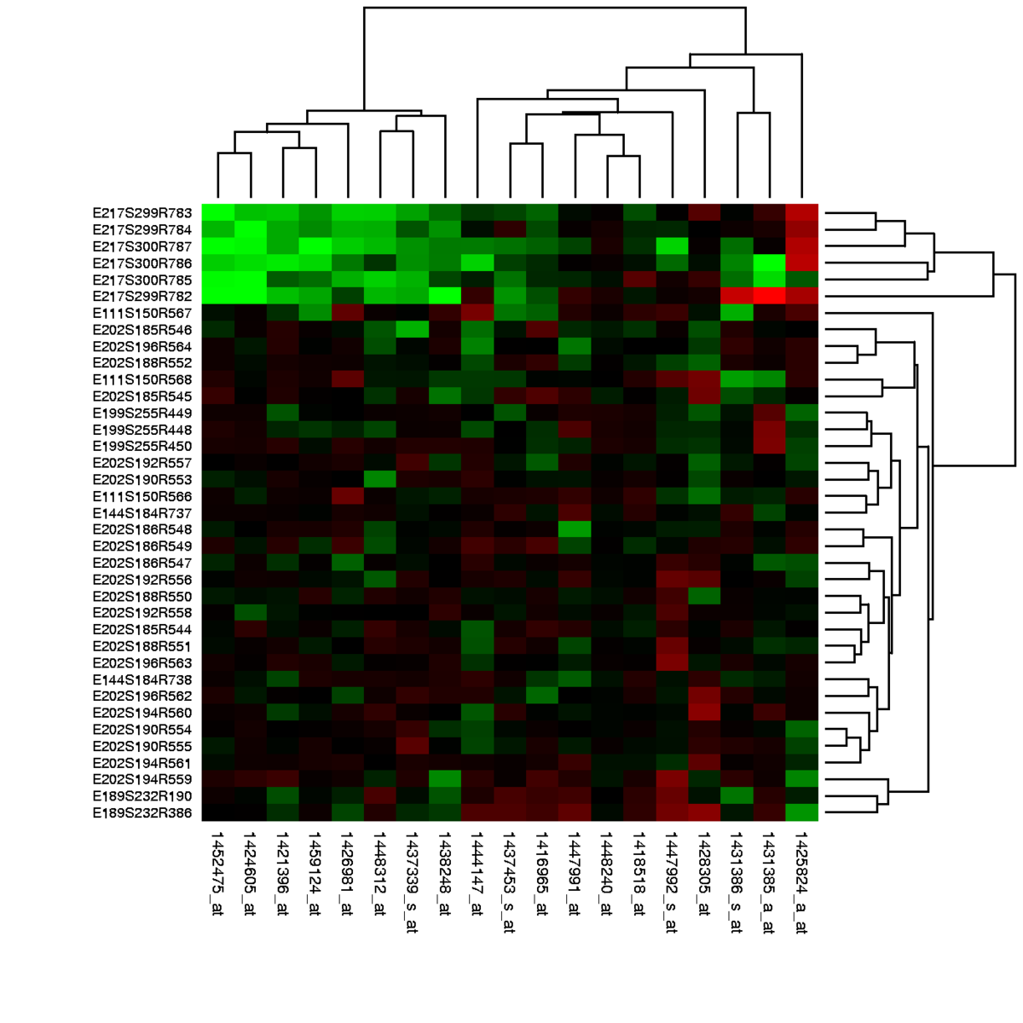
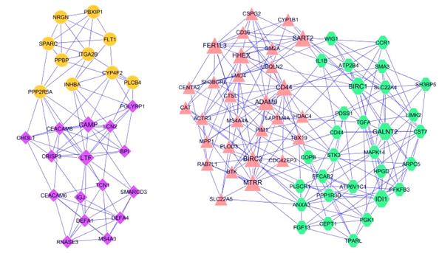
Example: gene regulatory network
Gene expression data
Network
Retrieved from https://en.wikipedia.org/wiki/Gene_expression_profiling
Retrieved from https://www.ese.wustl.edu/~nehorai/research/genomic/grn.html

Slide 4
Limitation of current methods
Lack of interpretability:
?
Statistical association
Biological hypothesis for validation
2. Lack of generalizability:
?
Study1
Study2

Slide 5

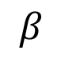
Stable association
Robust to perturbation
Generalizable
Perturbation
$$β$$
X1 X2
2. Causal implication
Interpretable
Bühlmann, P. (2020). Invariance, causality and robustness.

Slide 6
Stabilized Regression (Pfister et al. 2021)

Slide 7
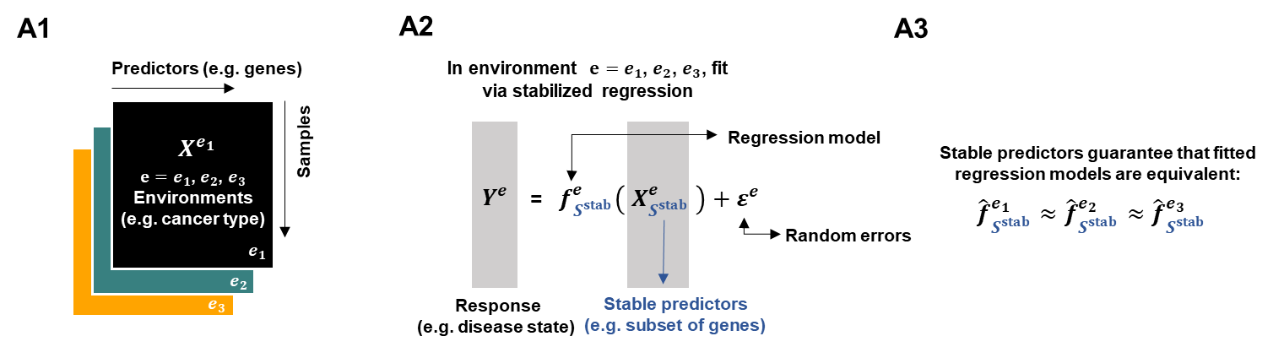
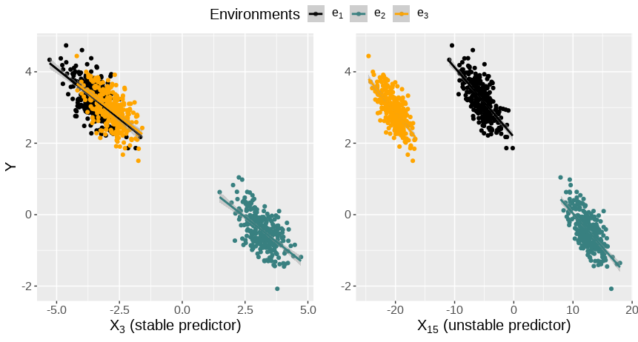
Goal of Stabilized Regression (SR)
Infer generalizable functional dependency on the response
Pfister, N., (2021). Stabilizing variable selection and regression

Slide 8
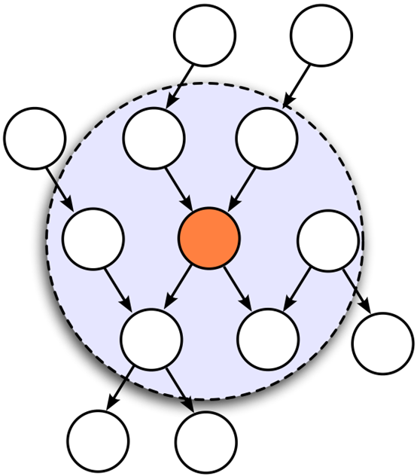
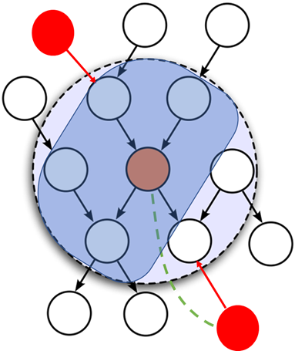
Markov Blanket and Stable Blanket
MB: The most predictive set
SB: The most predictive stable set
SB
MB
Environmental
intervention
PA <= SB <= MB

Slide 9
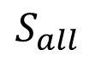
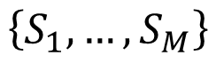
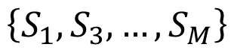
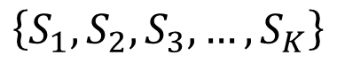
SR algorithm
Given a response, predictors and environments
$$S_{all}$$
Inaccurate:
Hard to generate enough subsets to test.
Random sample
$$\left\{S_{1},S_{2},S_{3},…,S_{K}\right\}$$
Stability test (e.g. Chow test)
Solution:
Over sample
Pre-filtering
$$\left\{S_{1},S_{3},…,S_{M}\right\}$$
Predictivity test (e.g. achieve smallest MSE)
$$\left\{S_{1}, …,S_{M}\right\}$$
Aggregate

Slide 10
StableMate (Deng et al. 2023)
Deng, Y., Mao, J., Choi, J., & Lê Cao, K. A. (2023). StableMate: a statistical method to select stable predictors in omics data. bioRxiv, 2023-09.

Slide 11
StableMate algorithm
based on stochastic stepwise (ST2, Xin et al, 2012) variable selection
Classic
ST2
Fit regression model.
Add or remove one variable per step.
Stop until no improvement.
Fit regression model.
Randomly subsample some predictor sets.
Add or remove one set per step
Stop until no improvement.
Xin, L., & Zhu, M. (2012). Stochastic stepwise ensembles for variable selection.

Slide 12
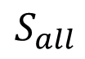
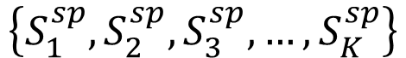
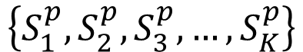
StableMate algorithm
$$S_{all}$$
SB must be the subset of MB
ST2: select predictive sets
$$\left\{S_{1}^{p},S_{2}^{p},S_{3}^{p},…,S_{K}^{p}\right\}$$
$$S_{k}^{sp}⊆S_{k}^{p}$$
ST2: select stable and predictive sets
$$\left\{S_{1}^{sp},S_{2}^{sp},S_{3}^{sp},…,S_{K}^{sp}\right\}$$

Slide 13
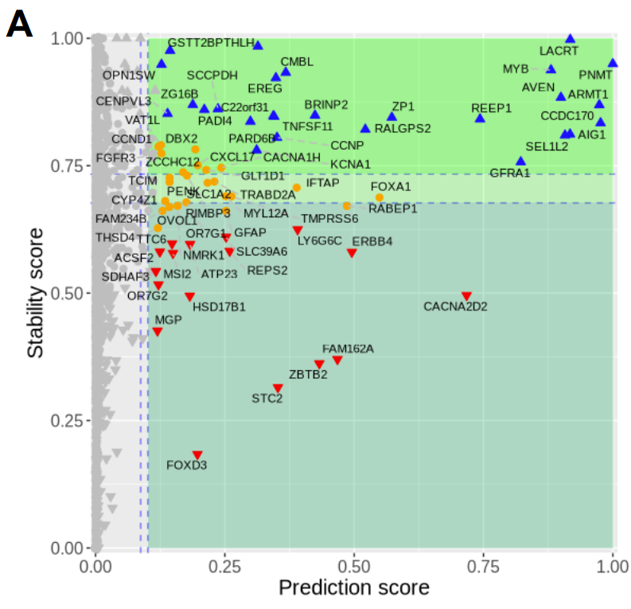
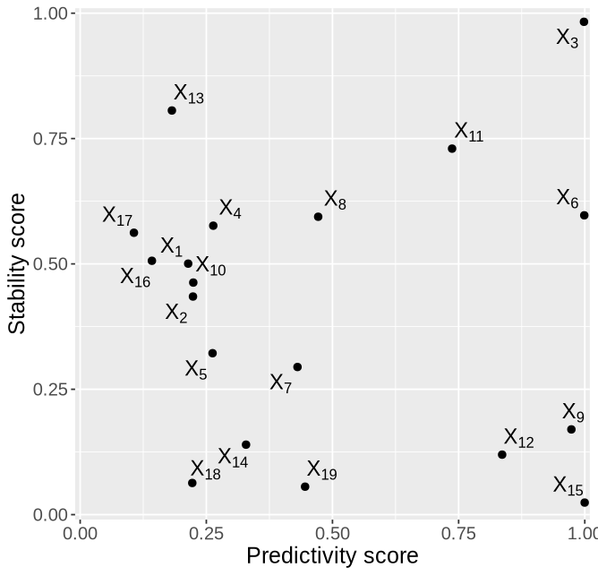
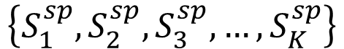
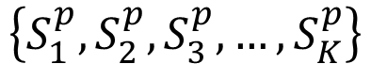
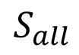
Objectives
$$S_{all}$$
ST2: minimize BIC
$$\left\{S_{1}^{p},S_{2}^{p},S_{3}^{p},…,S_{K}^{p}\right\}$$
ST2: optimize cross validation performance (MSE) across environments
$$\left\{S_{1}^{sp},S_{2}^{sp},S_{3}^{sp},…,S_{K}^{sp}\right\}$$
Calculate selection frequency

Slide 14
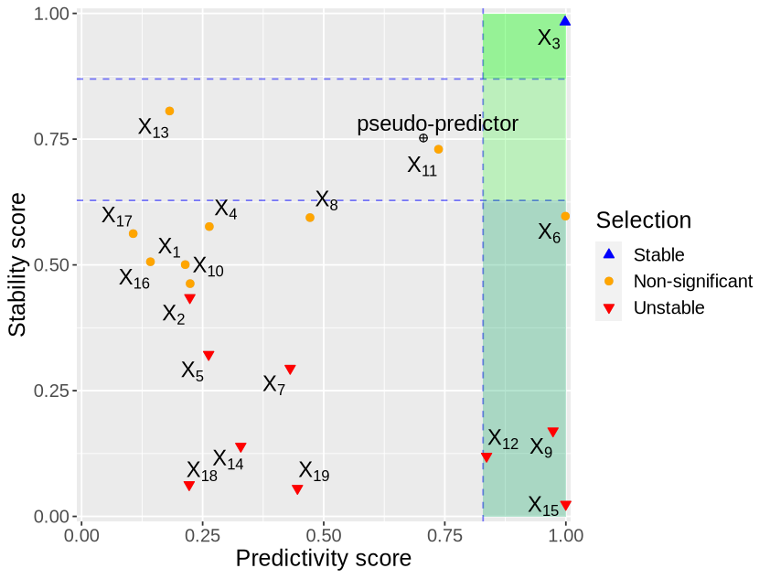
Make selection
Add a pseudo-predictor
(Can be selected but doesn’t influence model fitting).
$$S_{all}$$
Predictive and stable
$$\left\{S_{1}^{p},S_{2}^{p},S_{3}^{p},…,S_{K}^{p}\right\}$$
$$\left\{S_{1}^{sp},S_{2}^{sp},S_{3}^{sp},…,S_{K}^{sp}\right\}$$
Calculate selection frequency
Predictive but unstable

Slide 15
Simulation study

Slide 16
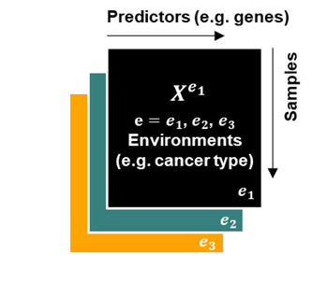
Setting
Simulate a structural causal model (SCM) in different environments
Generate data according to the SCM
(Three training, one testing environment)
Mask the SCM
Identify SB from observational data
Differs by exogenous perturbation

Slide 17
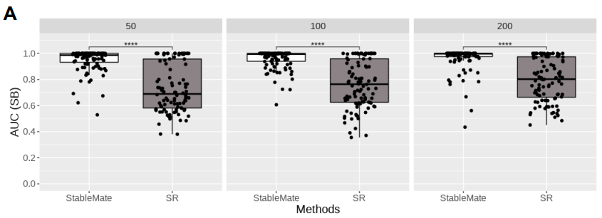
StableMate makes better selections

Slide 18
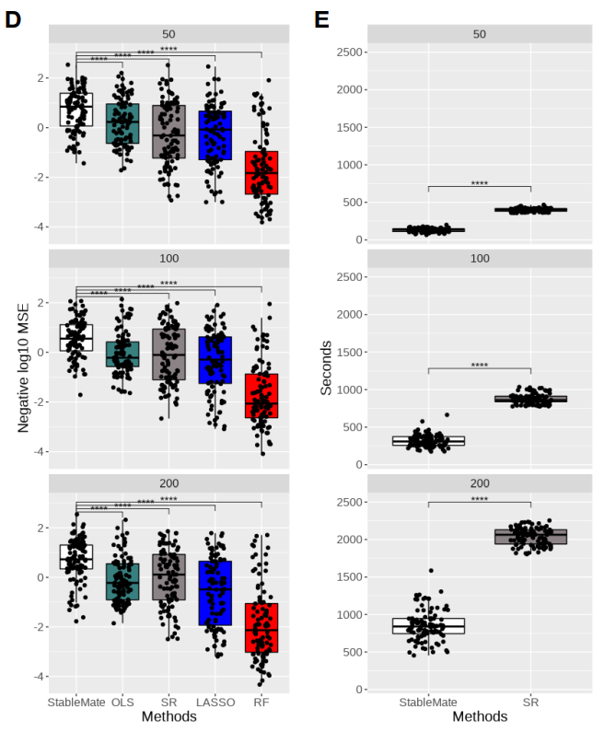
StableMate extrapolate better,
with greatly reduced running time

Slide 19
A case study on breast cancer RNA-seq data with BRCA gene mutation
Source: TCGA (The Cancer Genome Atlas Program) consortium
Data: RNA-seq (gene expression, a count matrix)
Response: ESR1 (estrogen receptor 1) gene expression
Environment: disease status (113 normal or 778 ER+ samples)

Slide 20
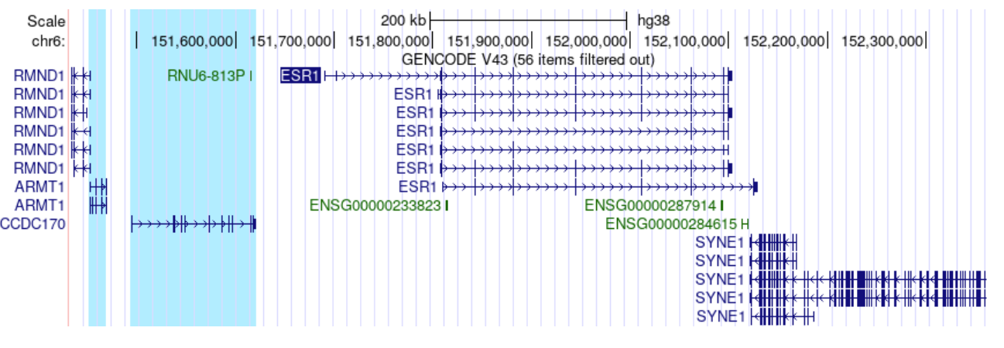
ESR1 vs other genes
ARMT1 and CCDC170 may subject to the same transcriptional regulation as ESR1

Slide 21
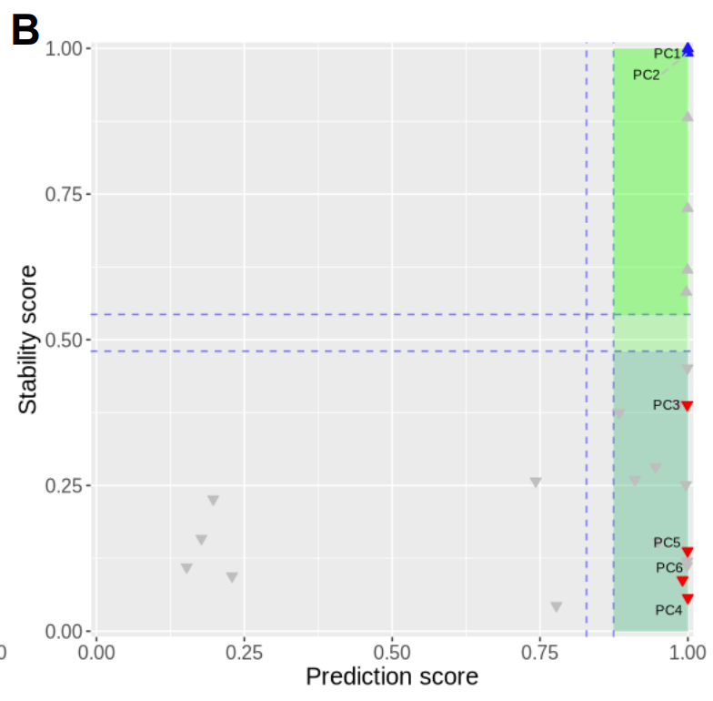
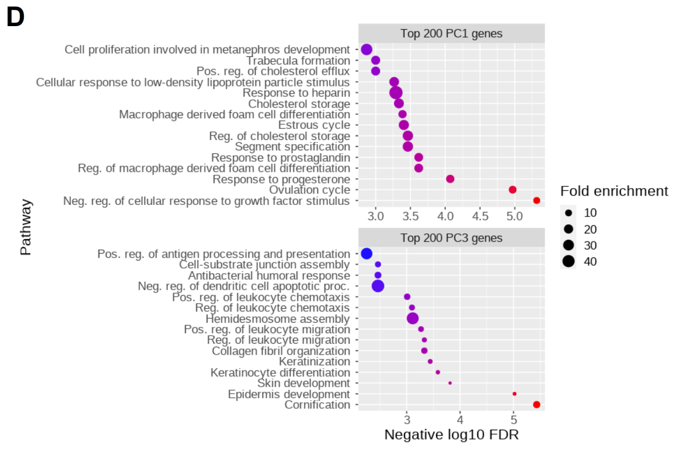
ESR1 vs principal components
(Estrogen receptor 1)
PC1 relates to hormonic regulation
PC3 relates to epidermis development

Slide 22
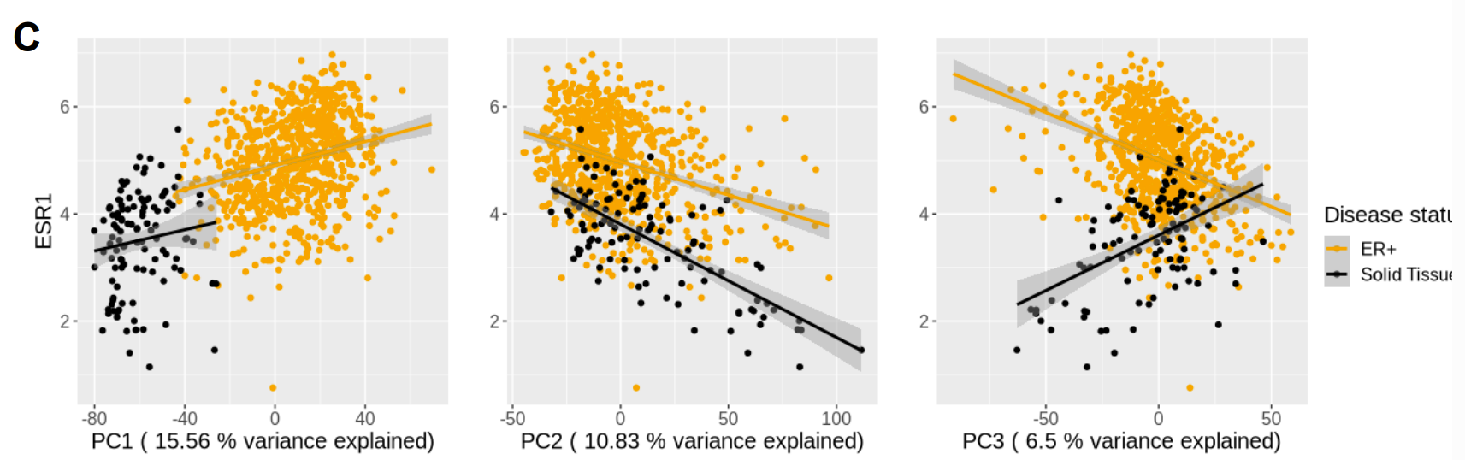
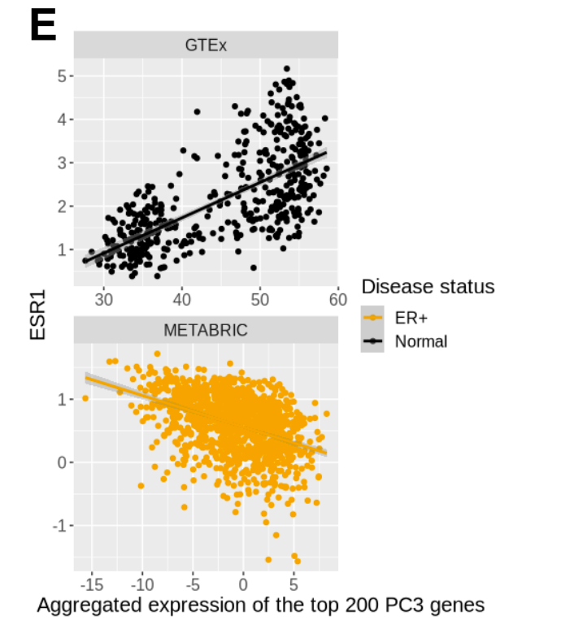
ESR1 vs principal components
Consistent pattern
Inconsistent pattern
StableMate reveals interesting functional heterogeneity to be investigated.
External validation on two consortium studies (GTEX, METABRIC)

Slide 23
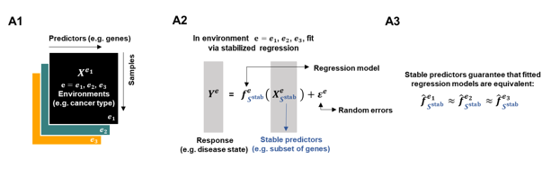
Summary
StableMate is a method for selecting consistent and inconsistent functional dependencies across heterogeneous datasets.
StableMate outperform Stabilized Regression.
StableMate makes interpretable inference of biological relationships via variable selection

Slide 24
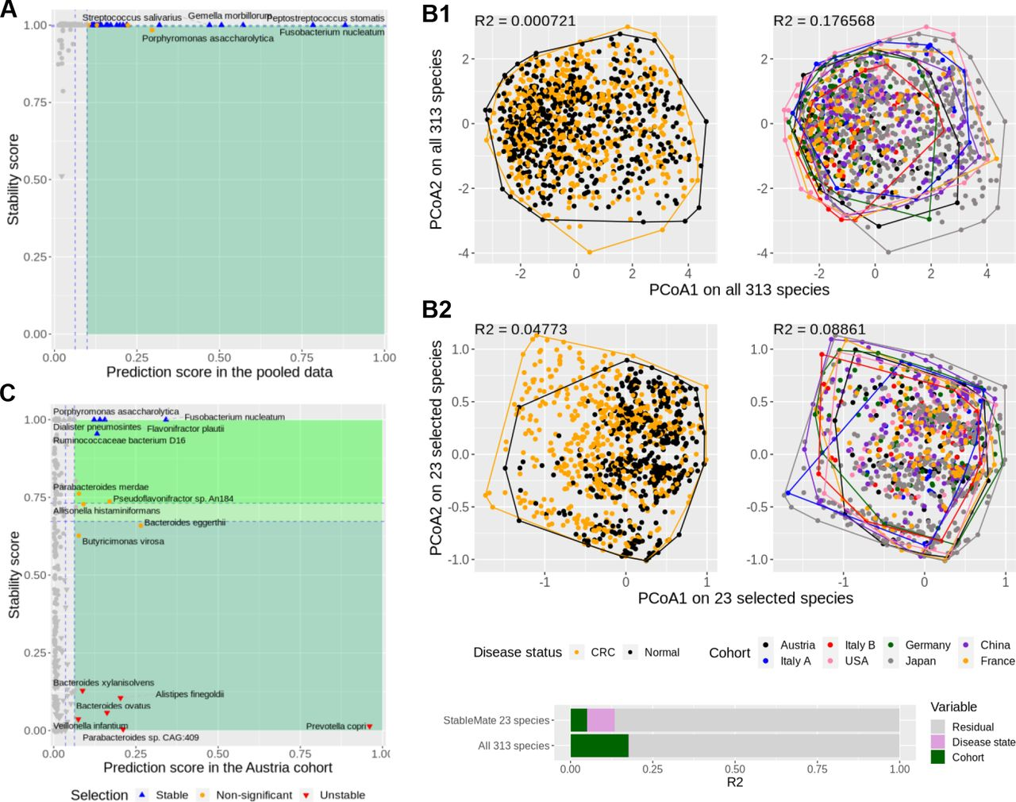
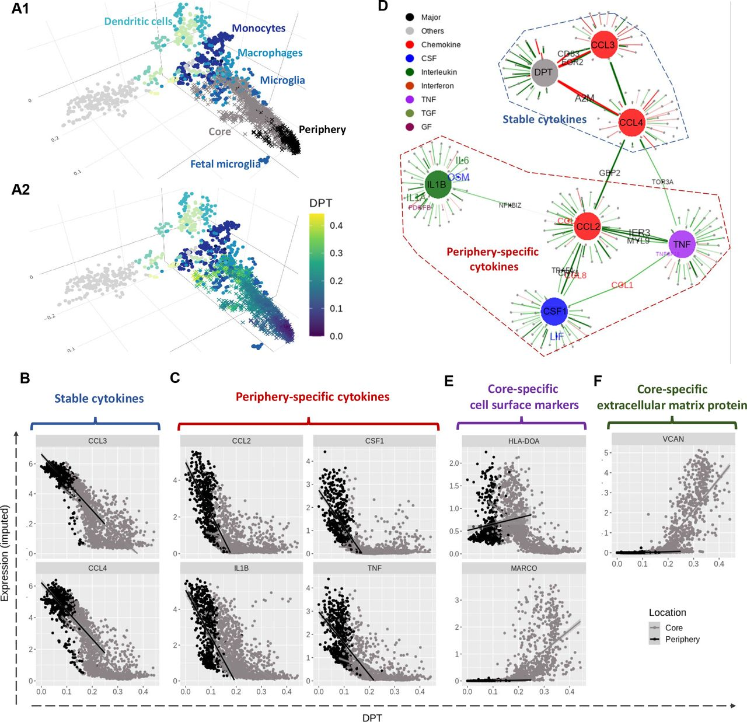
What else?
Metagenomic data: predict colon cancer incidence with fecal microbiome abundance
scRNA-seq data: Characterizing cell identity transition of glioblastoma tumor-infiltrating microglia
Deng, Y., Mao, J., Choi, J., & Lê Cao, K. A. (2023). StableMate: a statistical method to select stable predictors in omics data. bioRxiv, 2023-09.

